Slide 1

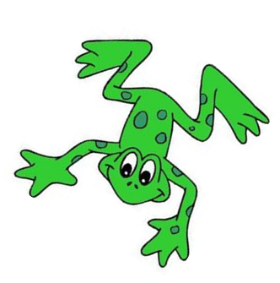
Green words
Speed Sounds set 1

Slide 2
1:1 words

Slide 3

mad

Slide 4
sad

Slide 5
dad

Slide 6
mat

Slide 7
sat

Slide 8
sam

Slide 9
1:2 words

Slide 10
in

Slide 11
on

Slide 12
it

Slide 13
an

Slide 14
and

Slide 15
pin

Slide 16
got

Slide 17
dog

Slide 18
sit

Slide 19
tip

Slide 20
pan

Slide 21
gap

Slide 22
dig

Slide 23
top

Slide 24
1:3 words

Slide 25
bin

Slide 26
cat

Slide 27
cot

Slide 28
can

Slide 29
kit

Slide 30
mud

Slide 31
up

Slide 32
cup

Slide 33
bad

Slide 34
back

Slide 35
kick

Slide 36
lock

Slide 37
1:4 words

Slide 38
met

Slide 39
set

Slide 40

fan

Slide 41
fun

Slide 42
fat

Slide 43
lip

Slide 44
log

Slide 45
let

Slide 46
had

Slide 47
hit

Slide 48
hen

Slide 49
ship

Slide 50
shop

Slide 51
fish

Slide 52
sack

Slide 53
1:5 words

Slide 54
red

Slide 55
run

Slide 56
rat

Slide 57
jog

Slide 58
jet

Slide 59
jam

Slide 60
vet

Slide 61
yap

Slide 62
yes

Slide 63
yum

Slide 64
web

Slide 65
win

Slide 66
wish

Slide 67
wet

Slide 68
sock

Slide 69
1:6 words

Slide 70
thin

Slide 71
thick

Slide 72
this

Slide 73
zap

Slide 74
zip

Slide 75
chin

Slide 76
chop

Slide 77
chat

Slide 78
quiz

Slide 79
quit

Slide 80
fox

Slide 81
box

Slide 82
fix

Slide 83
six

Slide 84
sing

Slide 85
bang

Slide 86
thing

Slide 87
wing

Slide 88
1:7 words

Slide 89

bell

Slide 90
well

Slide 91
mess

Slide 92
thing

Slide 93
think

Slide 94
wink

Slide 95
blob

Slide 96
brat

Slide 97
drop

Slide 98
drip

Slide 99
clip

Slide 100

from

Slide 101
frog

Slide 102
flag

Slide 103
flop

Slide 104
grin

Slide 105
gran

Slide 106
pram

Slide 107
prop

Slide 108
slip

Slide 109
slid

Slide 110
skid

Slide 111
trip

Slide 112
best

Slide 113
test

Slide 114
bend

Slide 115
jump

Slide 116
send

Slide 117
dress

Slide 118
kitten

Slide 119
kitchen

Slide 120
comic

Slide 121
seven

Slide 122
given

Slide 123
robin

Slide 124
lemon

Slide 125
ribbon

Slide 126
button

Slide 127
jacket

Slide 128
pocket

Slide 129
packet

Slide 130
ticket

Slide 131
rocket

Slide 132
puppet

Slide 133
bucket

Slide 134
rabbit

Slide 135
carrot

Slide 136
cannot

