Slide 1



Slide 2
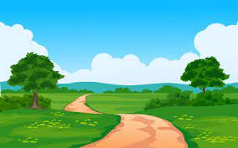

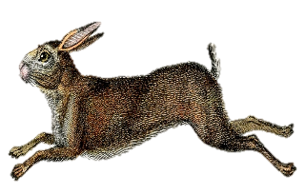
THE COUNTRYSIDE
CODE

Slide 3

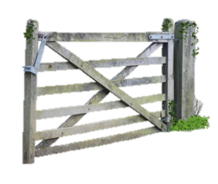
Gates
Do you know how you should leave gates in the countryside?
Notes:
Leave gates as you find them. Farmers usually close their gates but sometimes they keep them open to allow their animals to get food or water from another field.

Slide 4

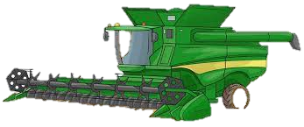
Respect the
Countryside
How do you think we should behave in the countryside?
Do you think it is ok to try and feed farm animals?
Do you think it is ok to walk wherever we want in the countryside?
Notes:
We must never touch farmers equipment or try to feed the animals.
Never pick wild flowers or disturb animals and leave nests alone.
Always use styles and gates don’t go through hedges or break fencing.

Slide 5

Litter
Do you think it’s ok to drop litter in the countryside?
What might happen if you do?
How can we stop this from happening?
Notes:
When we visit the countryside we must always keep it neat and tidy.
We don’t want animals to eat anything they shouldn’t and make them poorly
They may get caught up in unwanted packaging.
Take a bag with you to put your rubbish in so that you can take it home.
We also want to leave it looking lovely for everybody to enjoy.

Slide 6
Fire
  What sort of behaviour /actions of others, may cause a fire in the countryside?
  What areas can be affected?
  How can we prevent fires from happening?
Notes:
Barbeques and cigarettes thrown away can cause fires in the countryside.
Moorland can be very dry in summer and the ground can set on fire very easily.
Forests can also be set on fire when the leaves are very dry.
Always light barbeques in an area where you are allowed to do so.
Adults must never throw cigarettes on the floor
Always take your rubbish home.

Slide 7
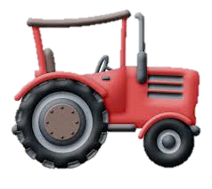
Stick To The Path
Why do you think it is important to stay on the right path?
Do you think the farmer would be happy if you walked on his field?
Do you know what the right path is called?
Notes:
You may wander into a field where there are crops and damage them.
You may walk in a field where the animals are not happy with strangers around.
You might get lost!
A farmer would be upset if you damaged his valuable crops or stressed out his animals.
The right path is called a public footpath look out for the signs,

Slide 8
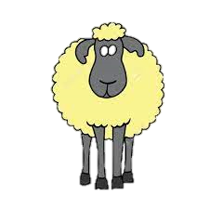
Keep Dogs Under Control
Why do you think we should keep dogs under control?
What types of dogs should be kept under control?
What does ‘under control’ mean?
Notes:
Dogs can run after sheep this can make them very stressed and make them very poorly or even die!
ALL dogs can chase sheep. Even your friendly fluffy pet can chase sheep and cause them harm
‘Under control’ means that they can not run away from you if they get excited when they see sheep.

Slide 9
Any Questions?

