Slide 1

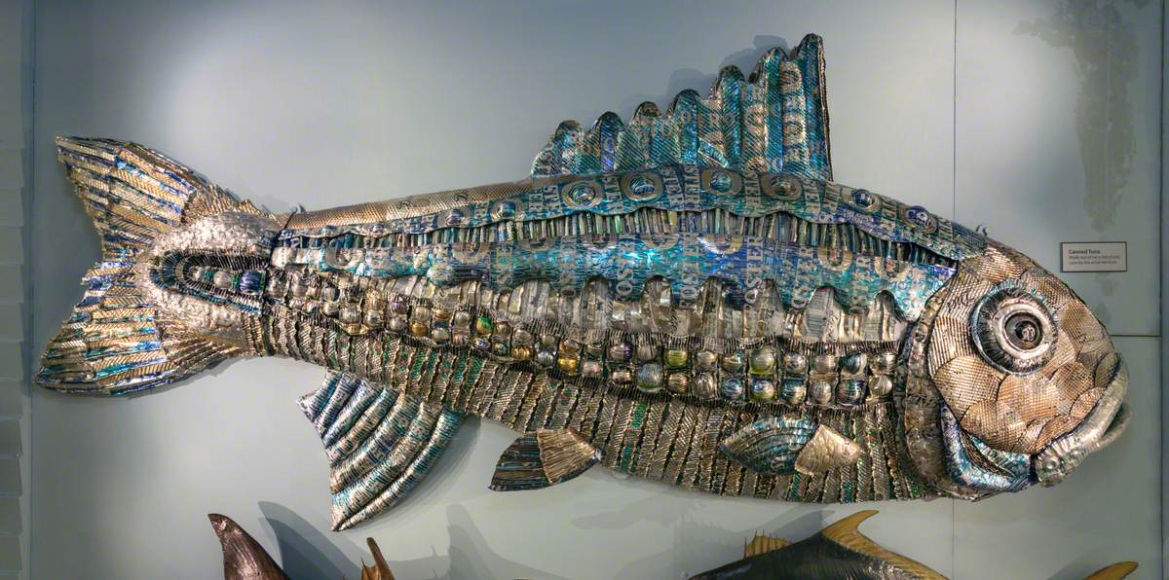
Canned Tuna Art
Artist Val Hunt created this piece in 2009 by recycling aluminium drinks cans! It’s on display in the museum in our Fish & Reptile Gallery next to casts of real fish.

Slide 2
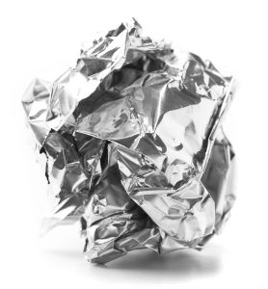
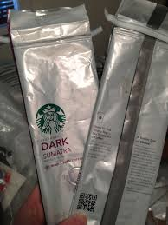
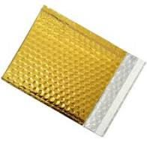
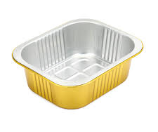
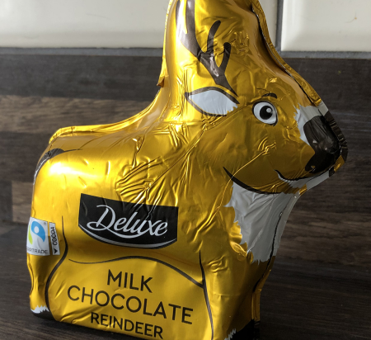
Create Your Own Fish!
Collect clean, shiny foils from packaging for recycling -I used wrappers from chocolate coins and chocolates, aluminium foil and a pouch for dishwasher tablets.

Slide 3
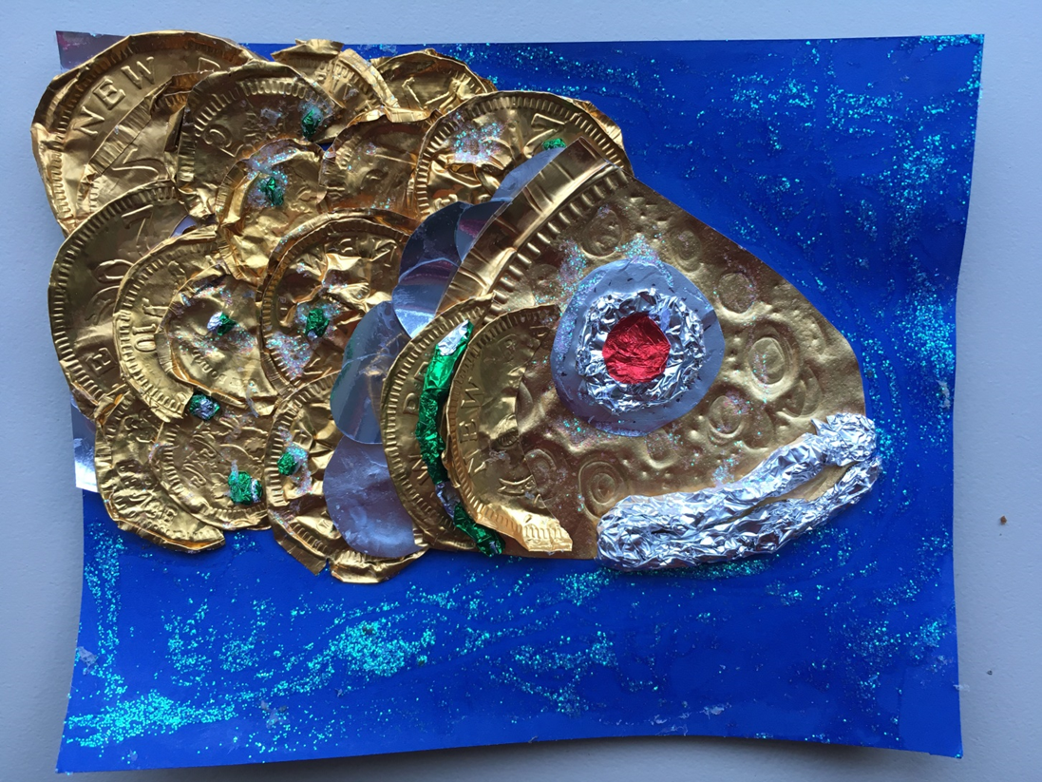
Start with the head
Take a thicker piece of foil like a pie dish to cut into a fish head shape. Build up the eye in layers of twisted foil to make a bulging fish eye. Twist more foil to create the fish’s thick lips.
Glue down onto a piece of plain or blue card. PVA glue is best for sticking the foils.

Slide 4
Add Scales
Create circles or oval shapes out of thicker and thinner foils and overlap them.
Let the shapes stick up a little to make it look more 3d.
Scrunch up colourful foil pieces to add colour and texture.

Slide 5

You could paint the background to create a blue and glittery sea…
You can add extra textures by pressing into the foil using a wooden stick or pencil. This is called embossing
Add glitter or glitter glue to create more shimmer!

