Slide 1
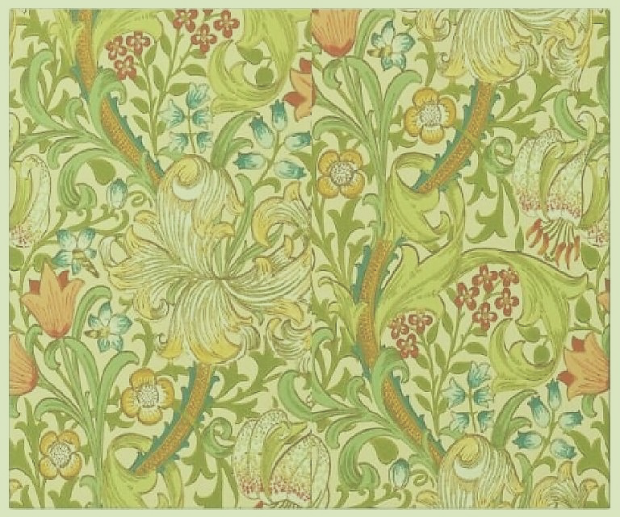

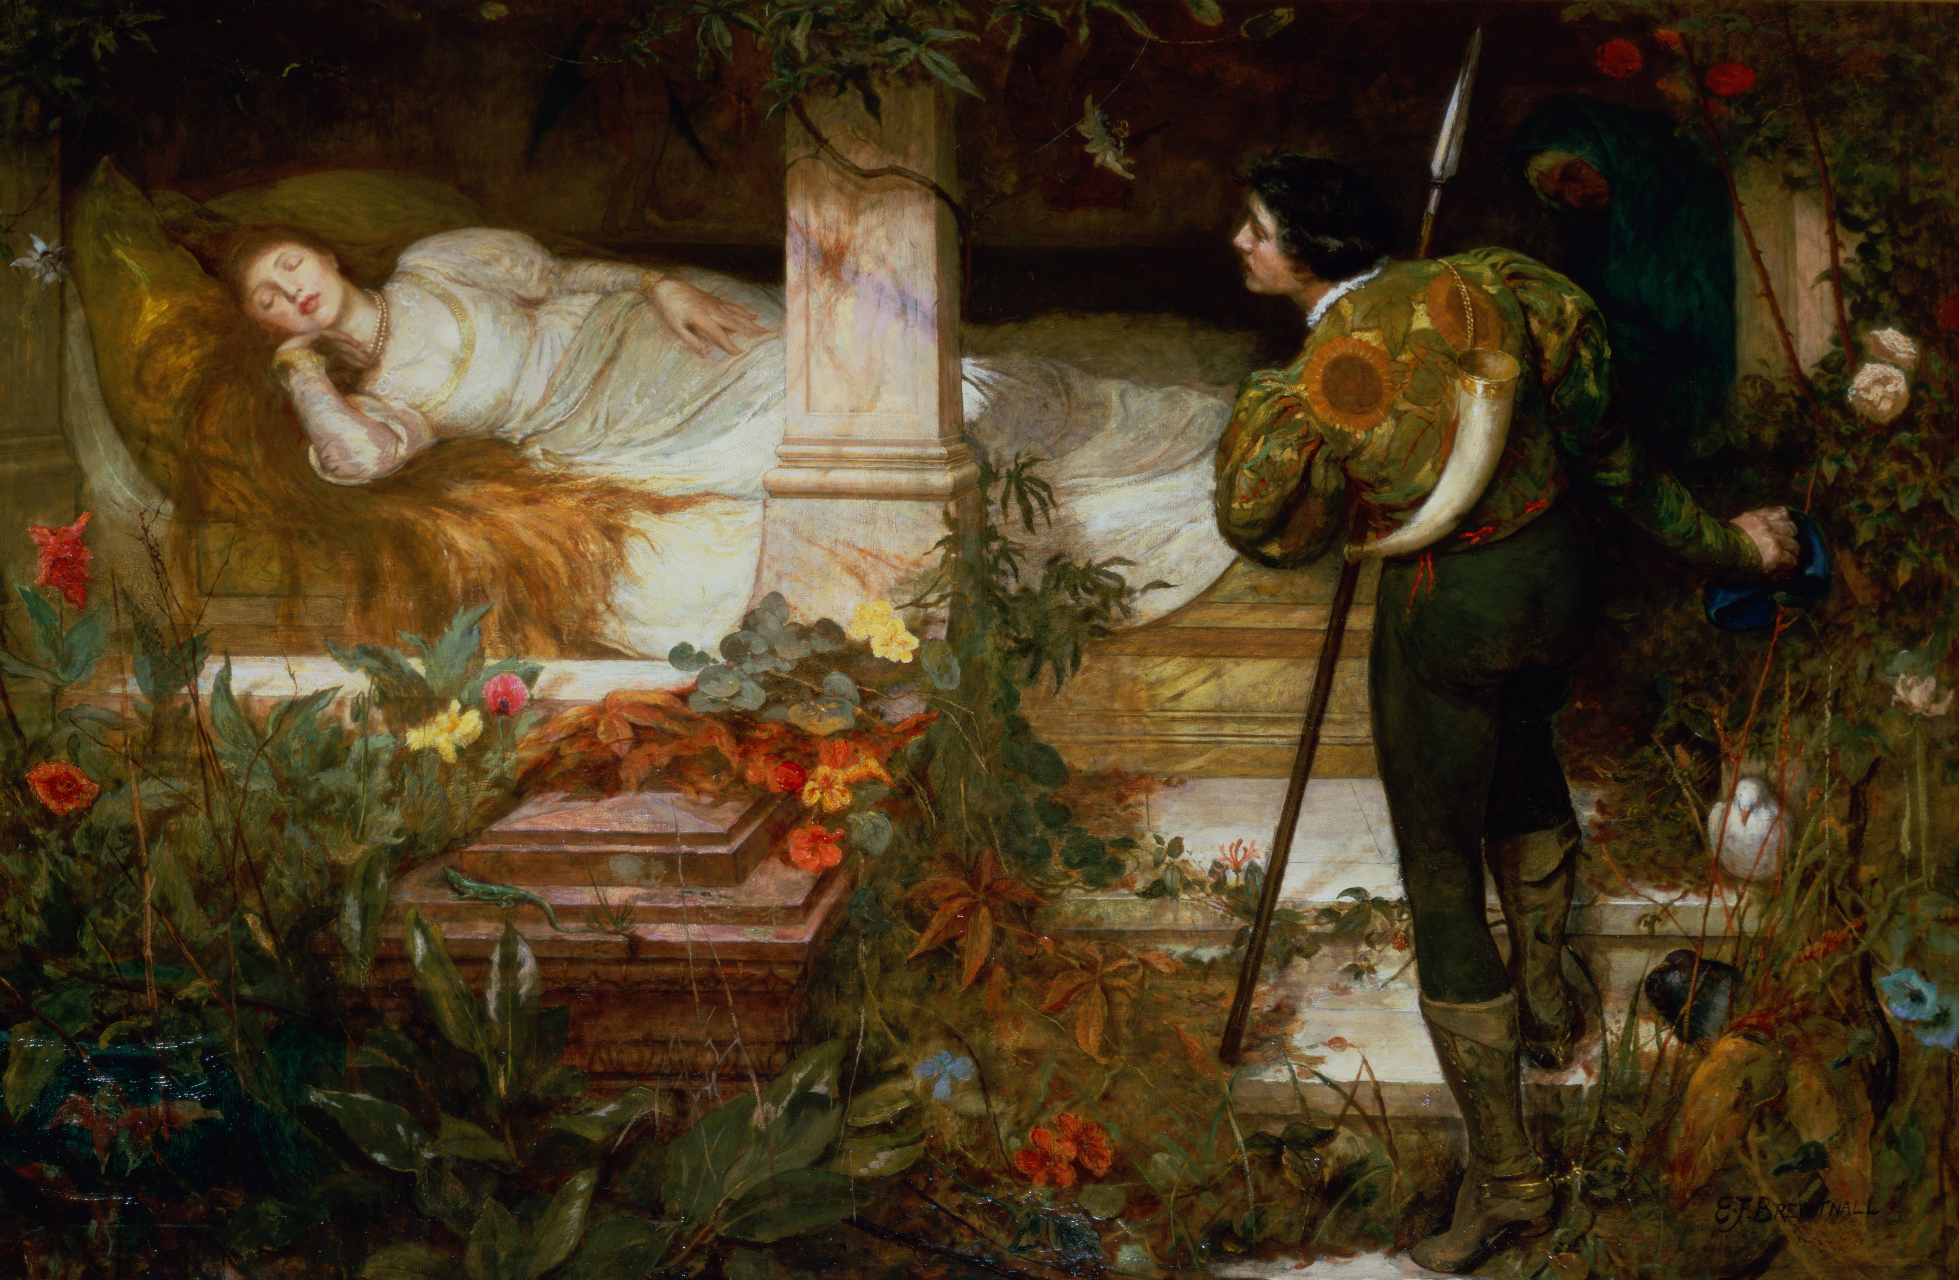
“Sleeping Beauty”
Edward Frederick Brewtnall

Slide 2
The Language of Flowers
Brewtnall attended the Warrington School of Art in the early 1860s when it was based in the museum.
He liked to paint romantic subjects or fairy tales.
To the Victorians, flowers conveyed a hidden meaning. The sunflowers in the hero’s jacket represent pure and lofty thoughts.

Slide 3
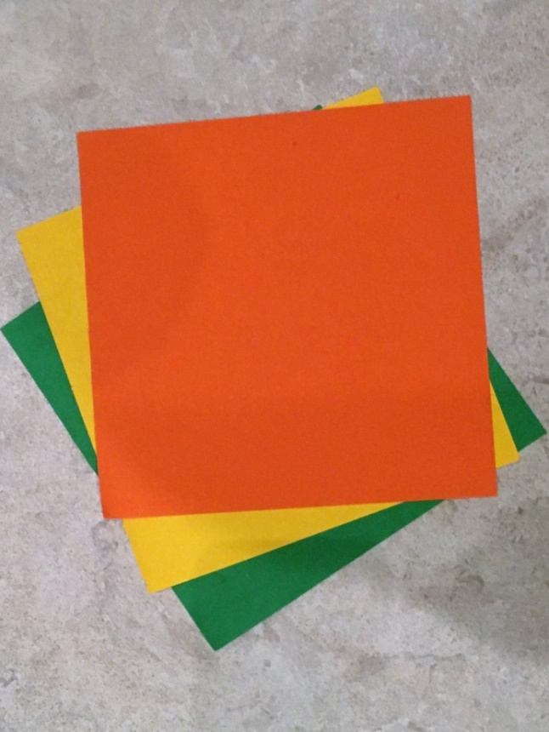
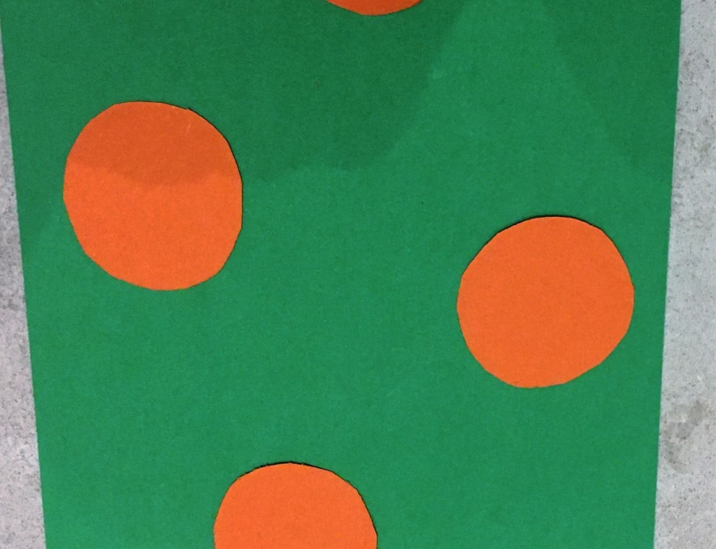
Create a flower design using paper collage
Choose three coloured papers depending on your chosen flower- I’m using sunflower colours with a green background as I chose the flower design of the hero’s jacket.
Cut the flower centres and arrange on the contrasting background.

Slide 4
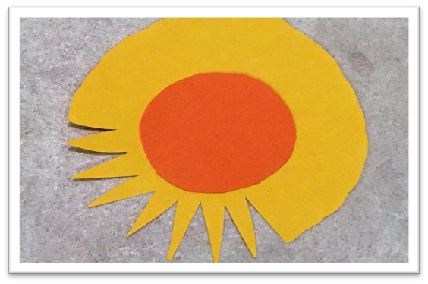
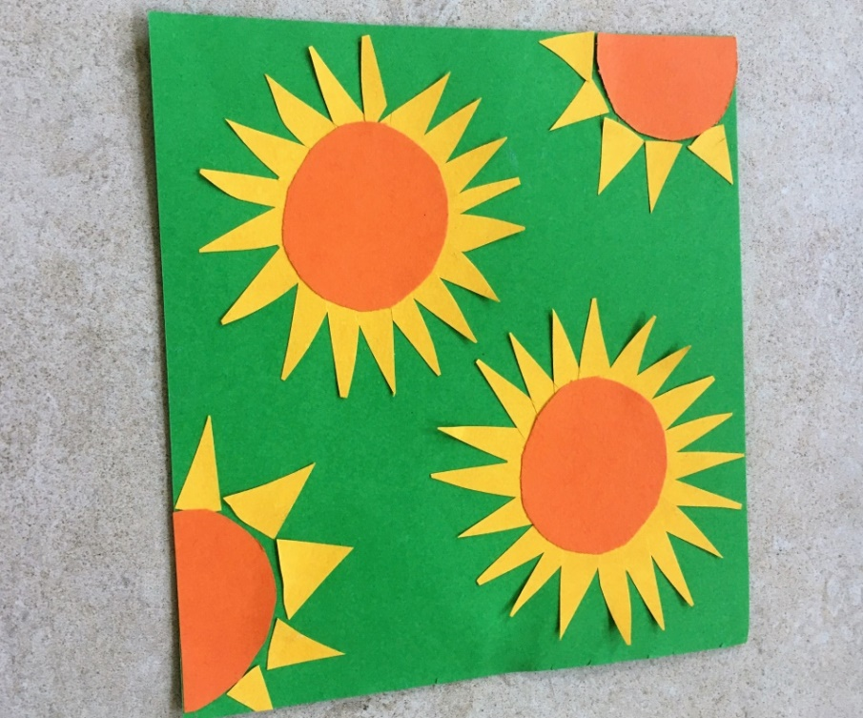
Arrange the flower centres. Use the triangles as petals for a couple of the flowers. When you’re happy with the lay-out, glue it all down.
Cut a larger circle for the petals and snip in. Keep the triangles you cut out.

Slide 5
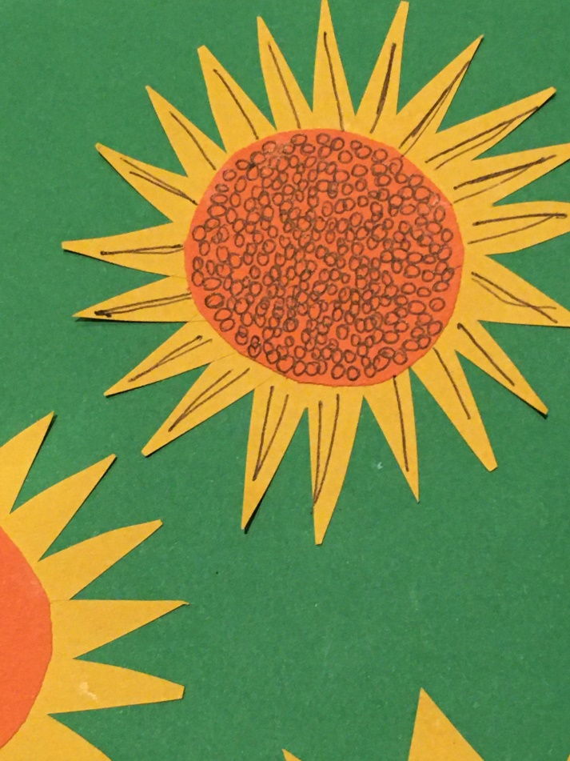
Add Texture Details
I added detail in pen- but you may prefer to keep to the coloured shapes.
You could choose a rose or lily - or another flower you can see in the painting as the basis for your design.

