Slide 1
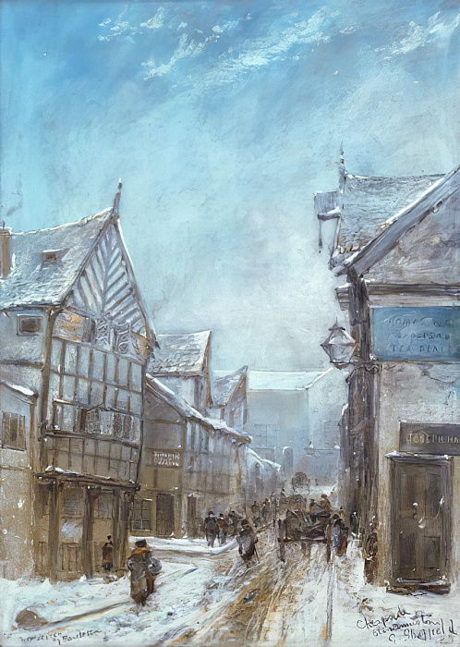
Old Cheapside 1864 by George Sheffield

Slide 2
Can you imagine a time when there were wooden houses like these in Warrington, near Golden Square shopping centre?
George Sheffield was an art student in Warrington, based at the museum in the 1850s. This work is often on display in the museum. It is painted using oils.

Slide 3
A covering of snow really does change things doesn’t it?
We can create a drawing of our home or an imaginary home or building in the snow.

Slide 4
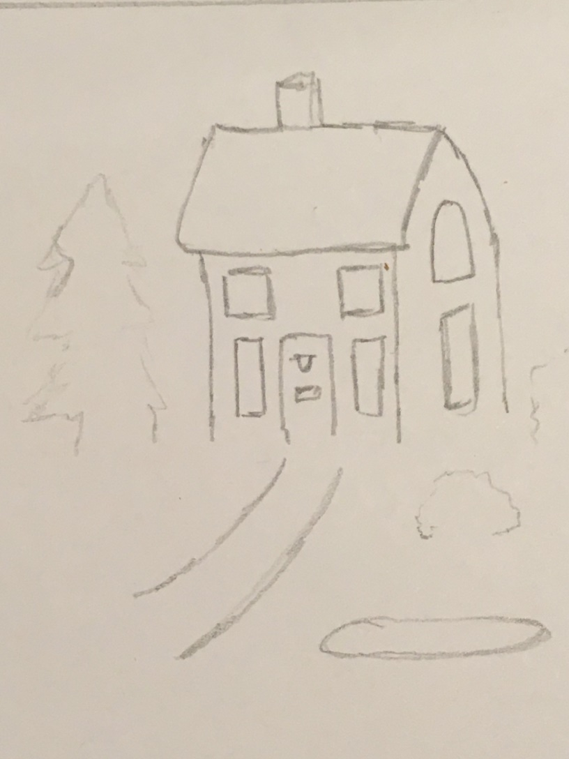
Create A House in the Snow
Draw a simple house with a few trees and bushes.
You don’t need to do the bottom of the house or trees as they’ll be in the snow.

Slide 5
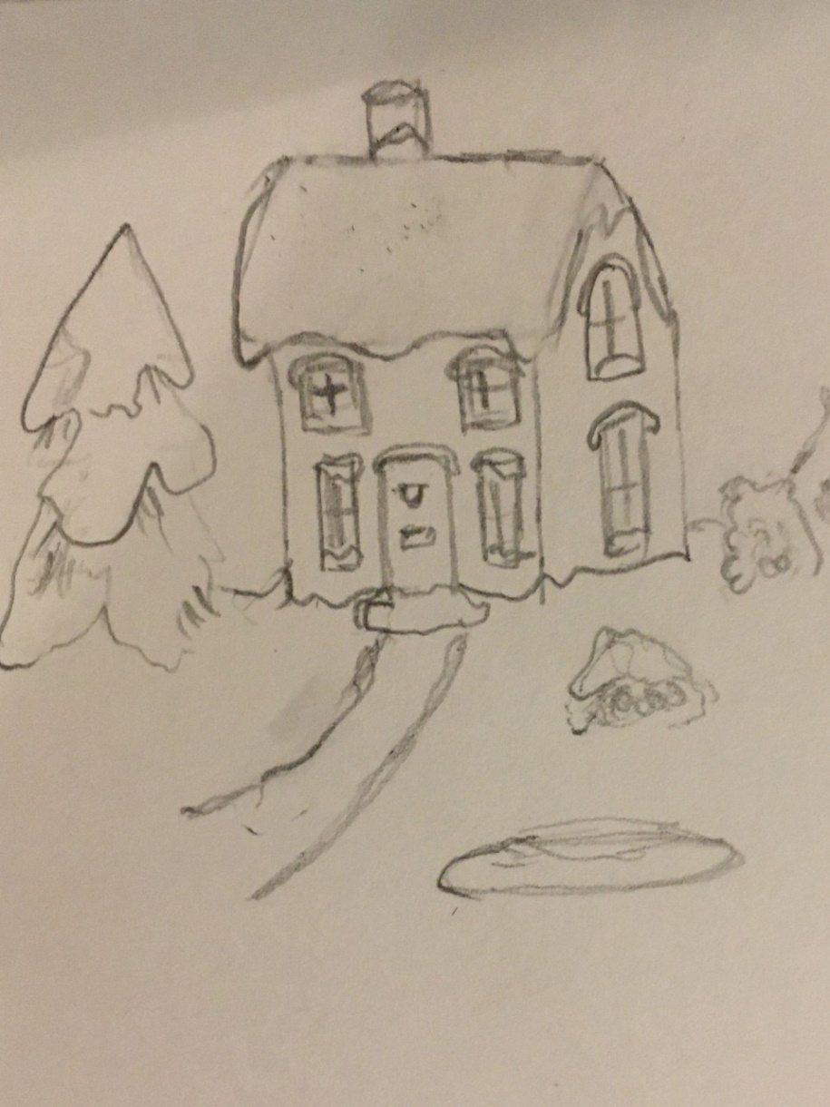
Soften Lines
Soften edges by curving the lines of the chimney, roof, windows, door and trees to create the look of overhanging snow.
Add a few details in the windows and garden.

Slide 6
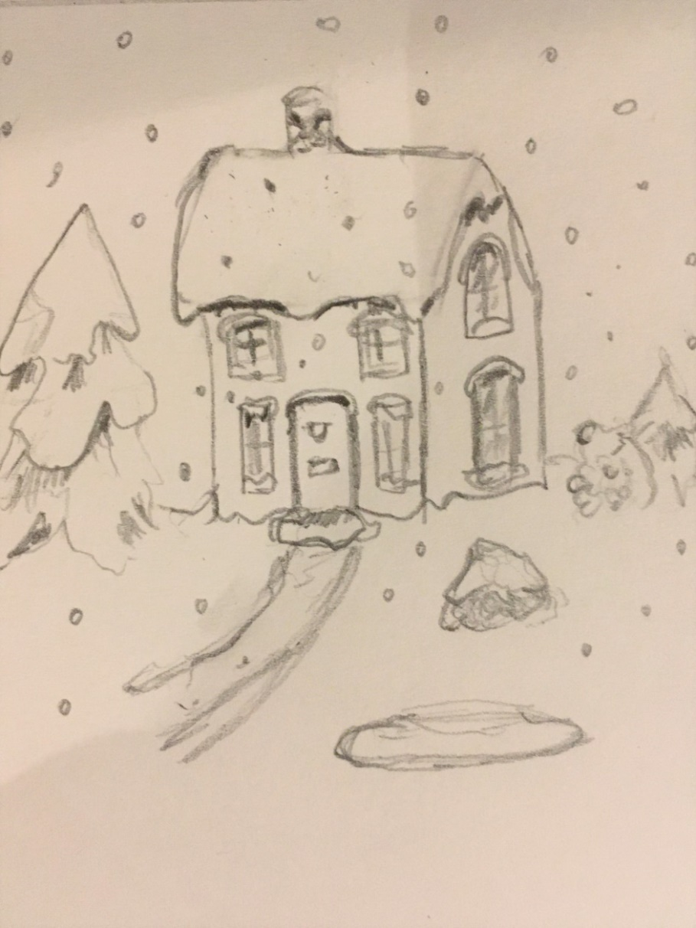
Add Shading
Add shading to bring out contrast- under the eaves and under the overhanging snow on the branches and chimney.
Add little circles and dots in different sizes to create snowflakes.

Slide 7
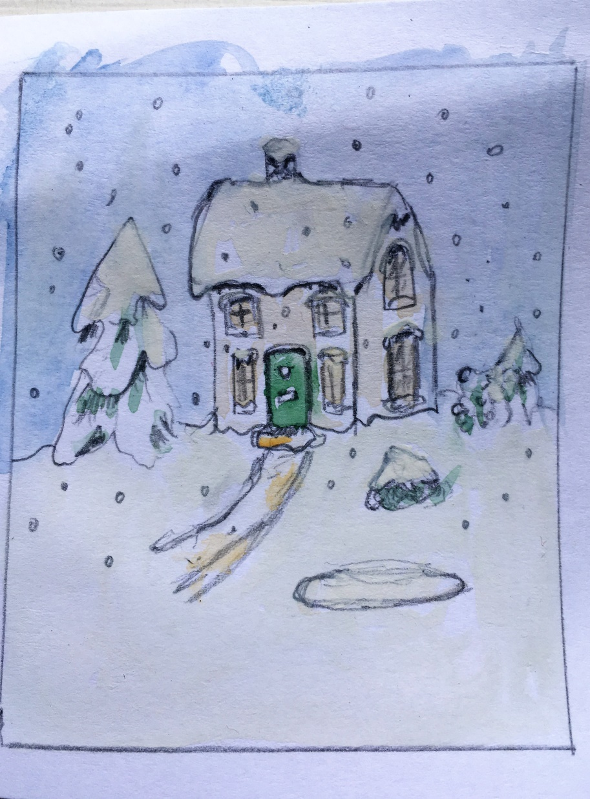
Add a Colour Wash
If you have water colour paints or pencil crayons, you could add loose colour washes for the snow, foliage and on the bricks or stone.

