Slide 1
FUNctional Skills
Pedagogy and Guidance

Slide 2
What are FUNctional Skills?
FUNctional skills refer to the combination of fun, meaningful life tasks with fundamental Maths and English skills from the classroom. FUNctional skills will allow pupils to:
Identify a problem and consider a suitable solution
Identify the skills that will be needed to solve the problem
Utilise the skills appropriately
Teaching FUNctional skills allows pupils to gain problem solving, transferrable skills which can be used throughout their lives. At Fox Wood, we believe that all pupils should have access to a FUNctional skills curriculum, from Reception to College. The skills introduced at reception may include using a visual timetable, following simple instructions and basic listening skills. These skills we be built upon and developed as the pupils’ progress through the key stages and will evolve into tasks such as running a business enterprise, deciding on prices for goods and working in ‘The Bungalow’ when the pupils reach college. The teaching of FUNctional skills will require teachers to look into daily activities/problems that take place and identify how we utilise Maths and English skills to solve them.

Slide 3
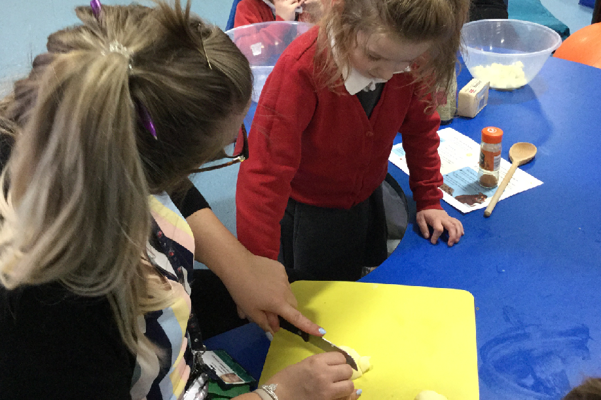
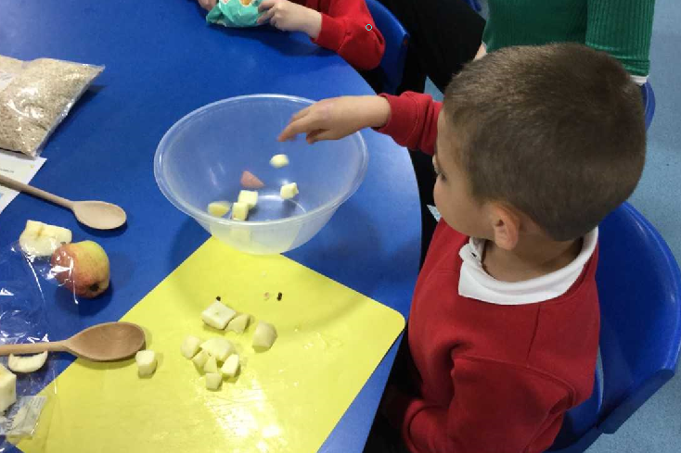
Timetable requirements
To ensure that FUNctional skills is being promoted across school, each class teaching a formal curriculum will be required to identify one session per week as a dedicated FUNctional skills session. This session must be dedicated to FUNctional skills development and can be delivered in any format/activity that is appropriate for your pupils. An example of this may be having a weekly shopping trip in which pupils can practice a variety of FUNctional skills – this could then be recorded and provided as a blog entry.
Pedagogy – process before product
The most important aspect of the theory underpinning FUNctional skills is that the emphasis is placed on the process rather than the end product. If the pupils can produce a quality finished product, whilst engaging in FUNctional learning, that is ideal. If this is not going to be the case, do not sacrifice quality FUNctional skills development and practice over producing a finished product! Evidence the process and the skills being practiced as this is the fundamental reason that we are doing FUNctional skills.

Slide 4
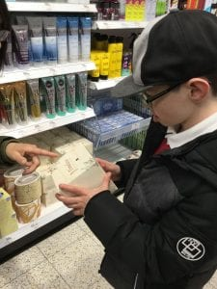
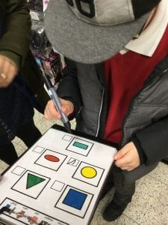
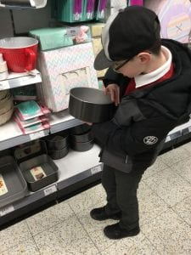
The Fun in FUNctional
This practical based learning will give a concrete aim to time spent in Food technology, enrichment and theme weeks. The activities should be fun, practical and hands on for the pupils. It can be topic based if you wish or subject based. Try to keep it relevant to the pupils and look for FUNctional opportunities in daily tasks/activities. This is a really good way for us to show the pupils the motive behind the skills that they are learning in class and how they can be applied to every day life.
The Curriculum
The curriculum tier that a pupil is working on will impact the opportunities that they will have to develop their FUNctional skills. Therefore, FUNctional skills will look very differently in a class working on the formal curriculum tier to a class working on the pre-formal curriculum tier. However, regardless of the tier there are a vast amount of FUNctional learning opportunities for all pupils. The curriculum needs to be built around the Maths and English skills that the pupil possesses and how they can put them into use for day to day activities. The following pages go some way to identifying a variety of FUNctional opportunities for pupils.

Slide 5
FUNctional Skills in the Pre-Formal Curriculum
There are a huge variety of activities that are classified as FUNctional skills. This is a non-exhaustive list of potential FUNctional skills opportunities for classes on the pre-formal curriculum tier:
Reflex – e.g. closing hands when fist is touched – placing coins in hands to pay for goods
Passive acceptance of adult led movements packing shopping bags, taking shopping out of bags
Touching textures with support – exploring different textures in supermarkets, at the park, walking out in the community
Reaching – voluntarily for an object – snack time, lunch time
Watching own movements – mirrors, swimming, PE
Maintaining attention on an object – a bird in a park, lunch, an item of shopping
Taking food from a spoon, chewing, swallowing – lunch, snack, in a restaurant
Demonstrating a brief interest in objects – tracking – watching an aeroplane, a bird, a car, tracking a familiar member of staff in a supermarket, watch an item being put in a shopping basket
Holding head steady to maintain eye contact
Reaching for objects across midline – self-service till, shopping items being put in a basket
Tasting
Making a shopping list – symbols, photographs
Opening drawers
Transferring objects from one hand to another- self-service till, items in a shop, food
Sieving mixtures with support
Being interested and exploring a new object
Manipulating materials in complex ways – dials/buttons
Pressing an object into soft material
Demonstrating hand to hand co-ordination – clapping, passing a cup from one hand to another
Observing and responding to different kitchen equipment – watching graters and exploring grated foods, being supported to use a grater, watch as staff cut food, attempts to cut own toast, uses correct end of knife with support
Stirring food in a bowl (hand under hand support),
Holding a spoon with purpose
Using photographs
Using voice to express an interest in something - anywhere
Expressing likes/ dislikes using switches, eye gaze, switches (activating kitchen equipment using a switch/ Powerlink)
Exchanging goods for money with support when shopping
Being supported to use the self-service tills
Choosing snack in a supermarket – eye pointing, symbols, real object choices
Using a rolling pin, shape cutter
Making own snack (with support)
Moving kitchen utensils through a horizontal/ vertical plane –Using a switch with decreasing levels of support to operate a piece of kitchen equipment

Slide 6
FUNctional Skills in the Semi-Formal Curriculum
There are a huge variety of activities that are classified as FUNctional skills. This is a non-exhaustive list of potential FUNctional skills opportunities for classes on the semi-formal curriculum tier:
Cutting food with support
Naming kitchen objects (pointing, symbols)
Knowing that the ‘ping’ from a microwave means the food is ready
Feels the temperature of food
Recalls the purpose of familiar kitchen utensils
Identifies what a kitchen item is made from e.g. – wooden/ metal spoon
Pushes a leaver on a toaster
Behaves in a safe way in the kitchen
Washes dishes with support
Identifies a dirty dish
Opens/ closes microwave door when requested
Identifies the purpose of kitchen appliances
Ordering simple instructions
Mark making
Copying labels
Weighing, measuring, which has more/ less, identifying heavier/ lighter
Expressing likes/ dislikes – signing, symbols, eye gaze, communication devices,
Identifying familiar print in the environment
Following a hand washing schedule
Buying resources and identifying what resources are needed
Navigating a shop with some independence
Writing a list
Referring to a list when shopping
Basic budgeting
Using a self- scan check out with some support
Checking use by dates
Following a basic recipe
Writing a recipe

Slide 7
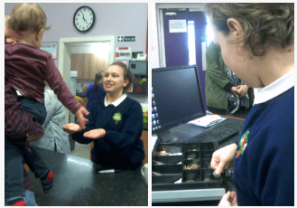
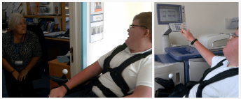
FUNctional Skills in the Formal Curriculum
There are a huge variety of activities that are classified as FUNctional skills. This is a non-exhaustive list of potential FUNctional skills opportunities for classes on the formal curriculum tier:
Reading from a shopping list
Reading signs in familiar and unfamiliar settings
Counting out the correct sum of money to pay for an item
Calculating the correct amount of change after paying
Recalling the purpose of familiar kitchen utensils
Reading an equipment list & locating the appropriate utensils
Using kitchen utensils safely to make a snack
Reading dials when operating equipment
Making and assigning labels
Listening to verbal instructions and responding appropriately
Counting the number of ingredients to make food items
Being able to extrapolate from a recipe for one item
Being able to read from a variety of tables and charts – e.g. a bus timetable
Using a search engine to answer a question
Using an information text to answer a question/look for information
Taking responsibility for whole class tasks – e.g. morning dinner routine
Identifying the items needed to ensure good personal hygiene
Developing road safety skills
Number and letter recognition when using a keyboard
Reading from a menu and ordering food/drink
Identifying equipment for taking different types of measures
Using a variety of equipment to take different measures

Slide 8
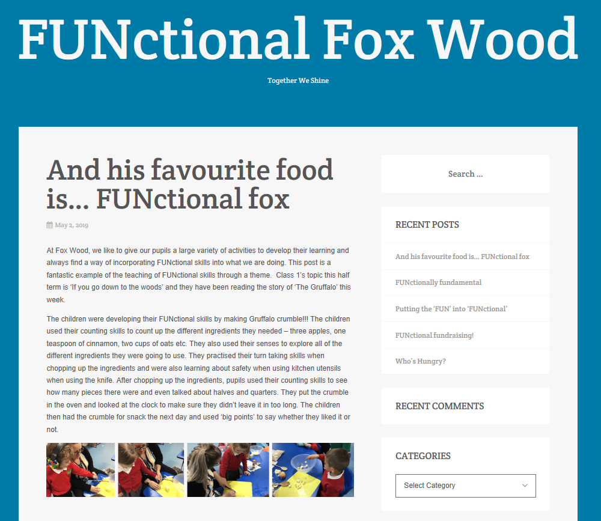
FUNctional skills blog - http://functionalfoxwood.edublogs.org/
In an effort to monitor the delivery of FUNctional skills across school, each class will be asked to provide a blog entry, with pictures and a write up, once per half term. This will be put on to the school’s FUNctional skills blog and will be accessible to the public. The blog entries need to be checked for spelling, punctuation and grammar prior to sending and it is the teachers responsibility to ensure all pupils on pictures have permission to go on to the internet. The second, and primary, use for the blog is to showcase what we are doing to external stakeholders. It is therefore requested that teachers endeavour to make parents aware of the blog at any given opportunity and that it is also pushed on the school’s other social media sites. The blog contains a share button at the bottom that allows it to be shared quickly via other social media outlets, so sharing should be a simple and straightforward process.
Each week, an email will be sent out to the applicable teachers reminding them that it is their week to provide a blog entry. This needs to be emailed by the end of the school day on Friday so that it can be posted by Friday evening.

