Slide 1
Online Safety Quiz

Slide 2
Match the app to the age
Snapchat - 13
Twitter - 13
Youtube – 13 with parents permission
TikTok - 13
Spotify – 13 with Parents permission
Xbox live – Any age
Instagram - 13
Facebook - 13
WhatsApp - 16
Fortnite - 12

Slide 3
Question 1
You took a really cool video of your friends having a water fight and you want to post it on social media.
Who should you ask before you post it?
A
B
C
No one, it is your video.
Your friends in the video.
Your parents or carers.

Slide 4
C
Your parents or carers need to check that the video is suitable for the internet and that it doesn’t give any personal information away about you or your friends.
They should also check your friends parents or carers are happy with it too.

Slide 5
Question 2
You are playing an online game and someone you don’t know wants to add you as a friend or talk to you.
What do you do?
A
B
C
Add them, its really nice to have more friends.
Let your parents or carers know so they can check who it is.
Ask the unknown person a few questions to get to know them first.

Slide 6
B
Even if you asked some questions, people online may not be who they say they are and can pretend to be someone different.
Never accept friend requests or talk to strangers online.
Talk with your parents or carers before accepting anyone online.

Slide 7
Question 3
You have posted a photograph of yourself on social media and someone has made nasty comments on the post
What should you do?
A
B
C
Get a trusted adult to help you straight away.
Comment something mean back, so they know how it feels.
Delete your photo so it cant happen again.

Slide 8
A
Don’t respond to it
Report it
Block them
Tell an adult

Slide 9
Question 4
Your best friend has given you their password and wants to know yours.
What do you do?
A
B
C
Make up a password to tell them, to make them happy.
Share your password, they’re a good friend and you can trust them.
Say that you cant share your password because it is just for you.

Slide 10
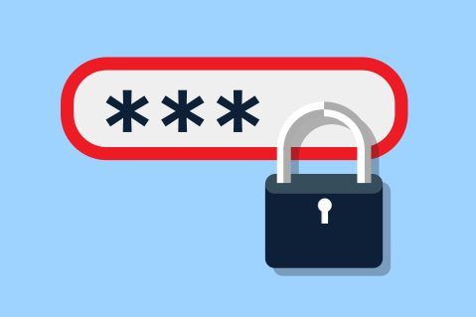
C
The only people you should share your passwords with are your parents or carers.
Never share your passwords with your friends.
Your friend should now change their password.

Slide 11
Question 5
Someone from another school wants to meet you in the playground after school so you can play out together, you know their name but you have never met them before.
What should you do?
A
B
C
Tell your parents or carers straight away.
Tell them you’ll be there after school and make sure your friends come with you.
Meet them in the playground, you’ve heard they’re really nice.

Slide 12
A
If someone that you don’t know ever asks you to meet up with them, you must tell your parents or carers straight away.
Never meet up with someone that you don’t know, even with your friends as you may be putting them in danger too.

Slide 13
Question 6
Who should you speak to FIRST if you feel worried about something you have seen online?
A
B
C
The people that run the website.
A trusted adult
A friend

Slide 14
B
Friends can often give you good advice but might not always know what to do for the best.
An adult that you trust, such as a parent, carer or teacher should always be the first person that you talk to.

Slide 15
Question 7
What should your gamer tag be when you’re playing online games?
A
B
C
Your real name
A nickname
Your best friends name

Slide 16
B
It is important that you don’t give any personal information out online – even your name

Slide 17
Question 8
You are chatting to someone online and they tell you not to tell your parents about them.
What should you do?
A
B
C
Keep them a secret because you don’t want to upset them
Stop talking to them
Tell your parents or carers about them and ask for advice

Slide 18
C
You should never keep anyone a secret, always be open and honest with your parents.
A real friend wouldn’t mind your parents knowing about them

Slide 19
Question 9
You are in a group chat on WhatsApp with 10 other friends, one friend starts saying nasty things so one person because they fell out in the playground that day, then the others join in.
Is sending nasty messages online a criminal offence?
A
B
Yes
No

Slide 20
A
Sending nasty messages to someone online is a criminal offence under the Malicious Communications Act
Which could lead to:
Your parents being informed.
Having to be interviewed at the police station.
Getting a criminal record.

Slide 21
Question 10
Your parents have given you online safety rules, but you are at your friends house and they don’t have any rules. You are playing online together
What should you do?
A
B C
Forget about the rules because you’re at your friends house where there isn’t any.
Not use the internet at all.
Use the internet but stick to the rules set by your parents.

Slide 22
C
Always stick to the rules set by your parents – they are there to keep you safe.

Slide 23
Question 11
Who’s responsibility is it to make the internet a safer place?
A
B
C
The industry
Yours as the user
Parents or carers

Slide 24
B
You are responsible for keeping yourself safe whilst using the internet
The industry and parents or carers can help

Slide 25
End of quiz
Thank you

